Slide 1
Lab Assignment # 3 Main Article summary
PSY 15
Mandy Small
February 10, 2021

Slide 2
Pieces of a TYPICAL ARTICLE
Title: Topic and information about the authors.
Abstract: Brief overview of the article.
Introduction: Background information and statement of the research hypothesis.
Methods: Details of how the study was conducted, procedures followed, instruments used and variables measured.
Results: All the data of the study along with figures, tables and/or graphs.
Discussion: The interpretation of the results and implications of the study.
References/Bibliography: Citations of sources from where the information was obtained.

Slide 3
Reading Strategies
Make a habit of condensing and paraphrasing what you read.
Finish an entire page or section before taking notes.
Take note of your thoughts and questions as you read. Don’t let them slip away!
Limit your highlighting and underlining.
Try annotating while you read
Make symbols to mark questions, main ideas, unknown words, and definitions that you encounter while reading.

Slide 4
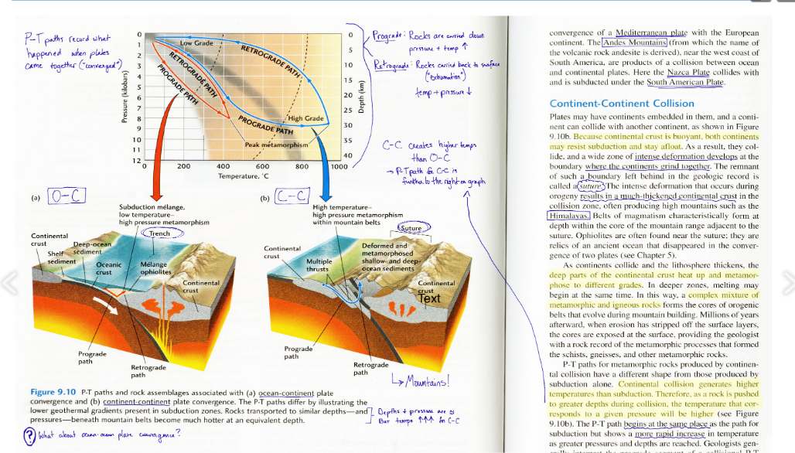

Slide 5
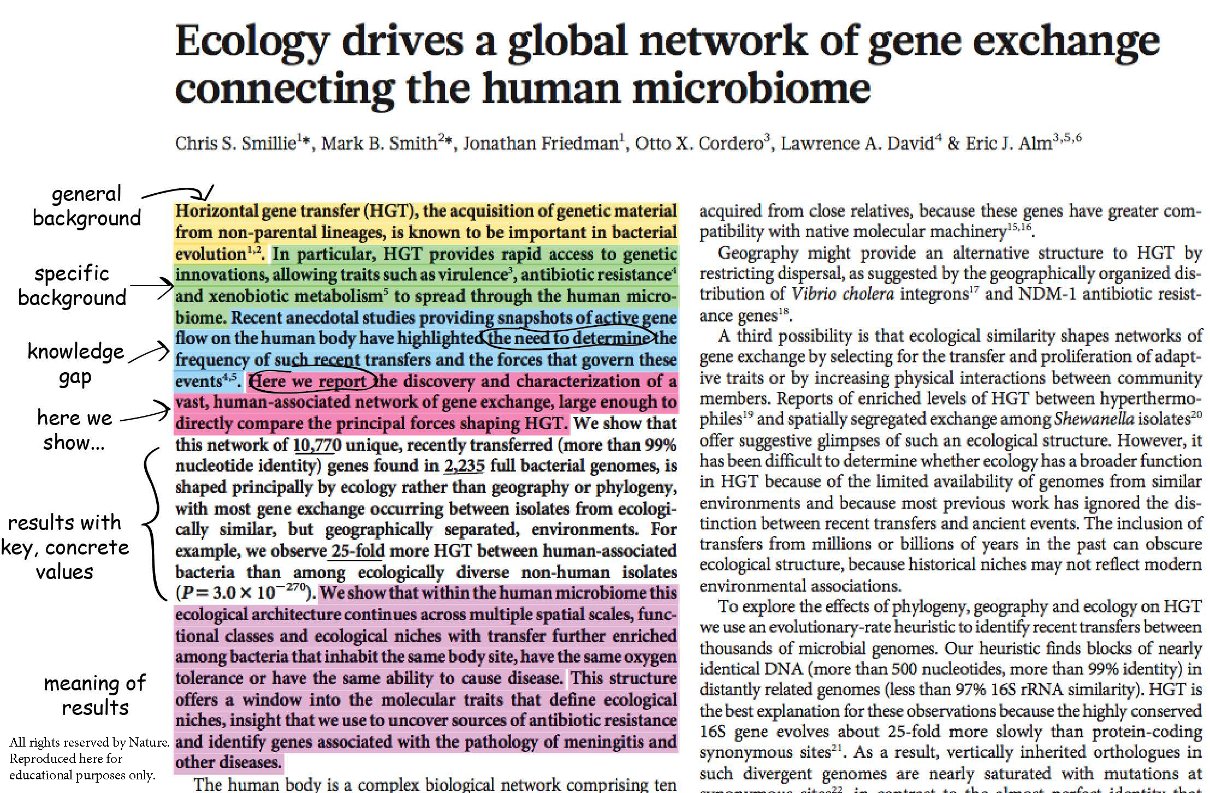

Slide 6
Instructions
Using the 5 peer-reviewed articles you identified in Assignment 2, select the most relevant article to your research question
Submit (in your own words) a written summary of the article
Follow the provided template
Remember, the goal is to summarize the topic, methods, and findings of your most relevant article
Assignment #3 is worth 15 points

Slide 7
Summary Template
Previous research on the topic / theoretical issues (from the introduction of the article):
Purpose of the study:
Summary of the methods:
Measures/Instruments used (definitions of the IV and DV?):
Summary of Findings:
Other Notes (could include next steps, quotes to use, methodological plans, etc.):

Slide 8
Example
Previous research on the topic / theoretical issues:
Uses attention restoration theory (ART) – attention is separated into two components, 1) involuntary attention, 2)voluntary/directed attention
Directed attention influences cognitive and emotional functioning, short term memory, and school success.
Previous research has suggested that
interactions with nature improve attention and memory
cognitive performance can be affected by glucose consumption and sleep
mediation may also restore directed attention.
Nature invokes involuntary attention, giving directed attention a rest and a chance to restore.
Hypothesized that directed attention is the one that is restored by interactions with nature.

Slide 9
Example
Purpose of the study:
Study 1: to determine how interactions with nature and urban environments affect cognitive performance.
Study 2: (to test ART) to determine if interactions with nature improve only executive attention (directed) and not alerting or orienting (which require less cognitive control).

Slide 10
Example
Summary of the methods:
Study 1: 38 University of Michigan undergraduates, completed a mood inventory, cognitive test, fatigue task, took a 50-55 minute walk (woods or urban), cognitive test, mood inventory and questions assessing the walk. Repeated again 1 week later with the other type of walk.
Study 2: 12 University of Michigan undergraduates, completed a mood inventory, cognitive test, ANT (attention test), viewed pictures for about 10 minutes (nature or urban), cognitive test, ANT, and mood inventory. Repeated again 1 week later with other set of pictures.

Slide 11
Example
Measures/Instruments used (definitions of the IV and DV?):
IV condition (nature/urban walk).
Study 1) a walk in a natural setting (park) or a walk in an urban setting (downtown).
Study 2) photos of natural settings (Nova Scotia) or photos of an urban setting (city scape).
DV
Study 1) cognitive performance - backward digit span;
Study 2) cognitive performance – backward digit span, and attention - ANT
Scales:
PANAS – mood inventory
Backward digit span – cognitive performance task
ANT – attention task

Slide 12
Example
Summary of Findings:
Interactions with nature do improve cognitive performance – performance is better after a walk in nature but not better after a walk in an urban environment; performance is better after looking at pictures of nature but not after looking at urban pictures.
Mood is also better after a walk in nature as compared to a downtown walk.
Nature does seem to refresh/restore directed memory but not involuntary memory.
Nature feels refreshing to people.

Slide 13
EXAMPLE
Other Notes (could include next steps, quotes to use, methodological plans, etc.):
“In sum, we have shown that simple and brief interactions with nature can produce marked increases in cognitive control. To consider the availability of nature as merely an amenity fails to recognize the vital importance of nature in effective cognitive functioning.”
Author’s suggestions for next steps: compare the effects of nature to other interventions also shown to influence cognitive performance: glucose consumption, sleep, meditation.

Slide 14
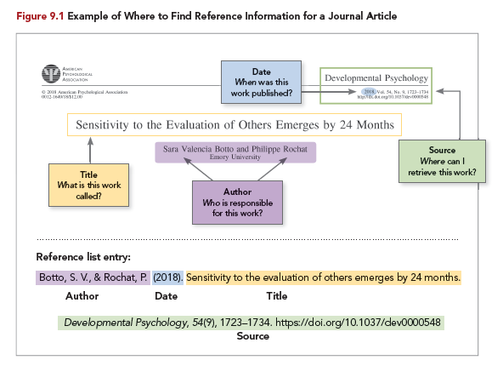

Slide 15
Formatting and Due Date
Type this assignment
12 point, Times New Roman font.
Use APA formatting for the reference.
Include your name and section number.
Submit your work to CatCourses by 11:59 PM on February 17th, Wednesday (no late work will be accepted).
Pdf format only

